Slide 1


Group 03 – Final Project
Lakshmi, Manjinder, Toby, Alireza, Tony, Pouria, Suteash, Kien, Alireza, Parsa, Sahar
Group 03 – Final Project
Lakshmi, Manjinder, Toby, Alireza, Tony, Pouria, Suteash, Kien, Alireza, Parsa, Sahar

Slide 2
Group 03 – Final Project
Group 03 – Final Project
Lakshmi, Manjinder, Toby, Alireza, Tony, Pouria, Suteash, Kien, Alireza, Parsa, Sahar
Lakshmi, Manjinder, Toby, Alireza, Tony, Pouria, Suteash, Kien, Alireza, Parsa, Sahar
Project Overview

Slide 3
Group 03 – Final Project
Project Overview
Lakshmi, Manjinder, Toby, Alireza, Tony, Pouria, Suteash, Kien, Alireza, Parsa, Sahar

Slide 4
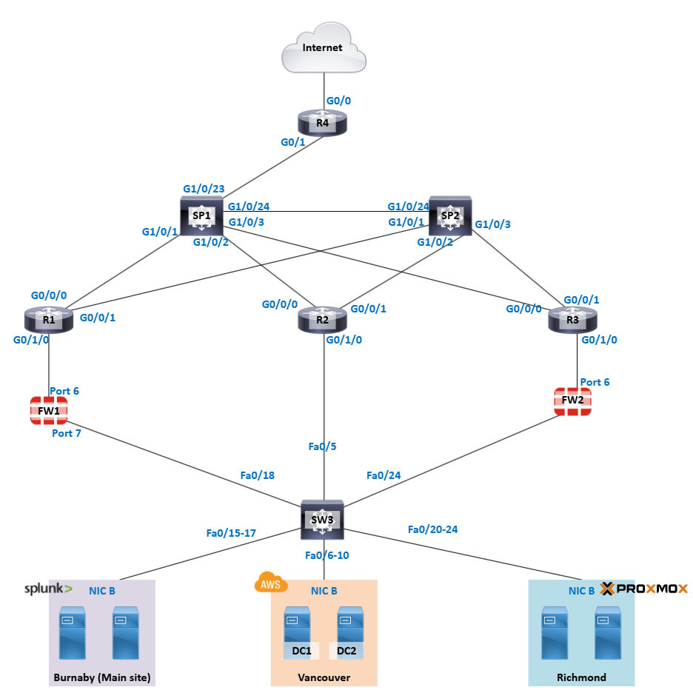
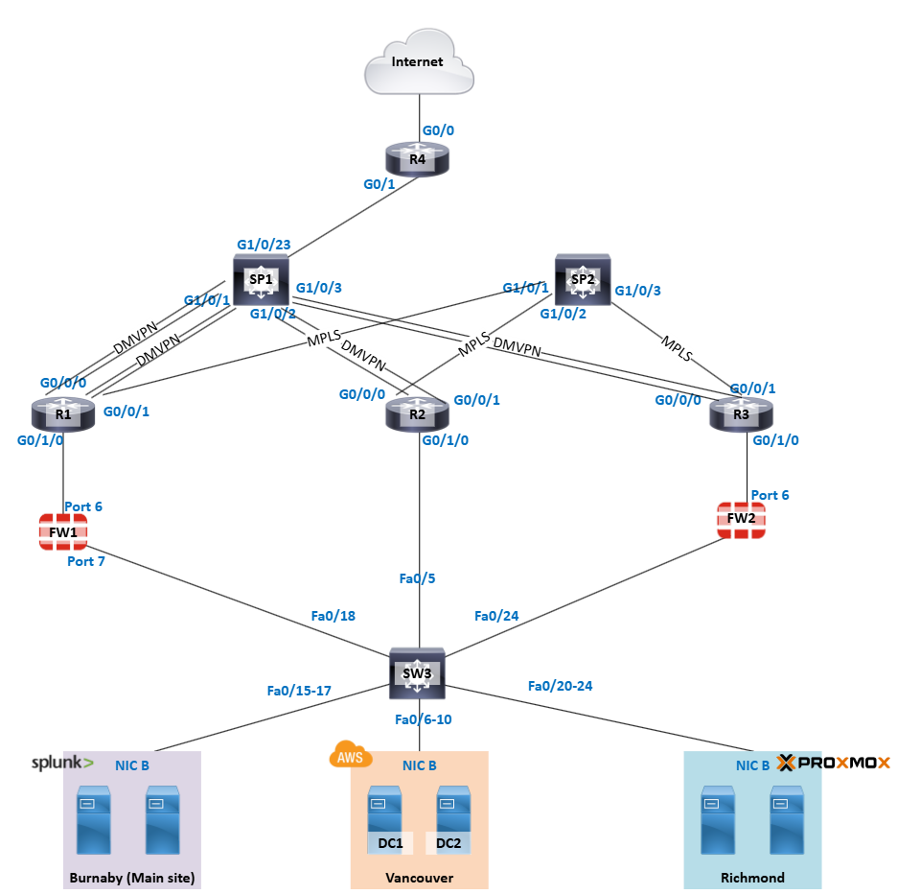
Implemented a three-layer hierarchical topology: Core, Distribution, and Access layers.​
Ensured no single point of failure by incorporating redundancy.​
Deployed redundant core switches and routers for failover.​
Configured ipv4 and ipv6 addressing
Efficient IP allocation and IP addressing with VLSM for future ip usage

Slide 5
Group 03 – Final Project
Project IN DETAIL
Lakshmi, Manjinder, Toby, Alireza, Tony, Pouria, Suteash, Kien, Alireza, Parsa, Sahar

Slide 6
Networking
VLANs were used to segment the network into logical groups for better security and traffic management
DMVPN was implemented to enable secure, scalable, and dynamic communication between remote sites
MPLS provided high-performance, reliable routing across multiple branch locations
OSPF was used as the dynamic routing protocol to ensure efficient path selection and network convergence
Static routes were configured for predictable, manual traffic direction where dynamic routing was not needed
NAT was used to translate private IP addresses to public ones for internet access
DHCP server was set up to automatically assign IP addresses between each site

Slide 7
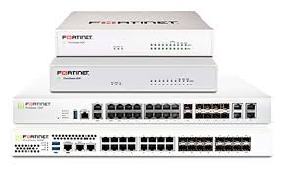
Network Security
Fortinet firewall placed before network to filter incoming traffic for security
Set polices to control incoming and outgoing network traffic
Configured site-to-site VPNs to encrypt data between our sites.
Added static routes to ensure proper traffic flow between networks.

Slide 8
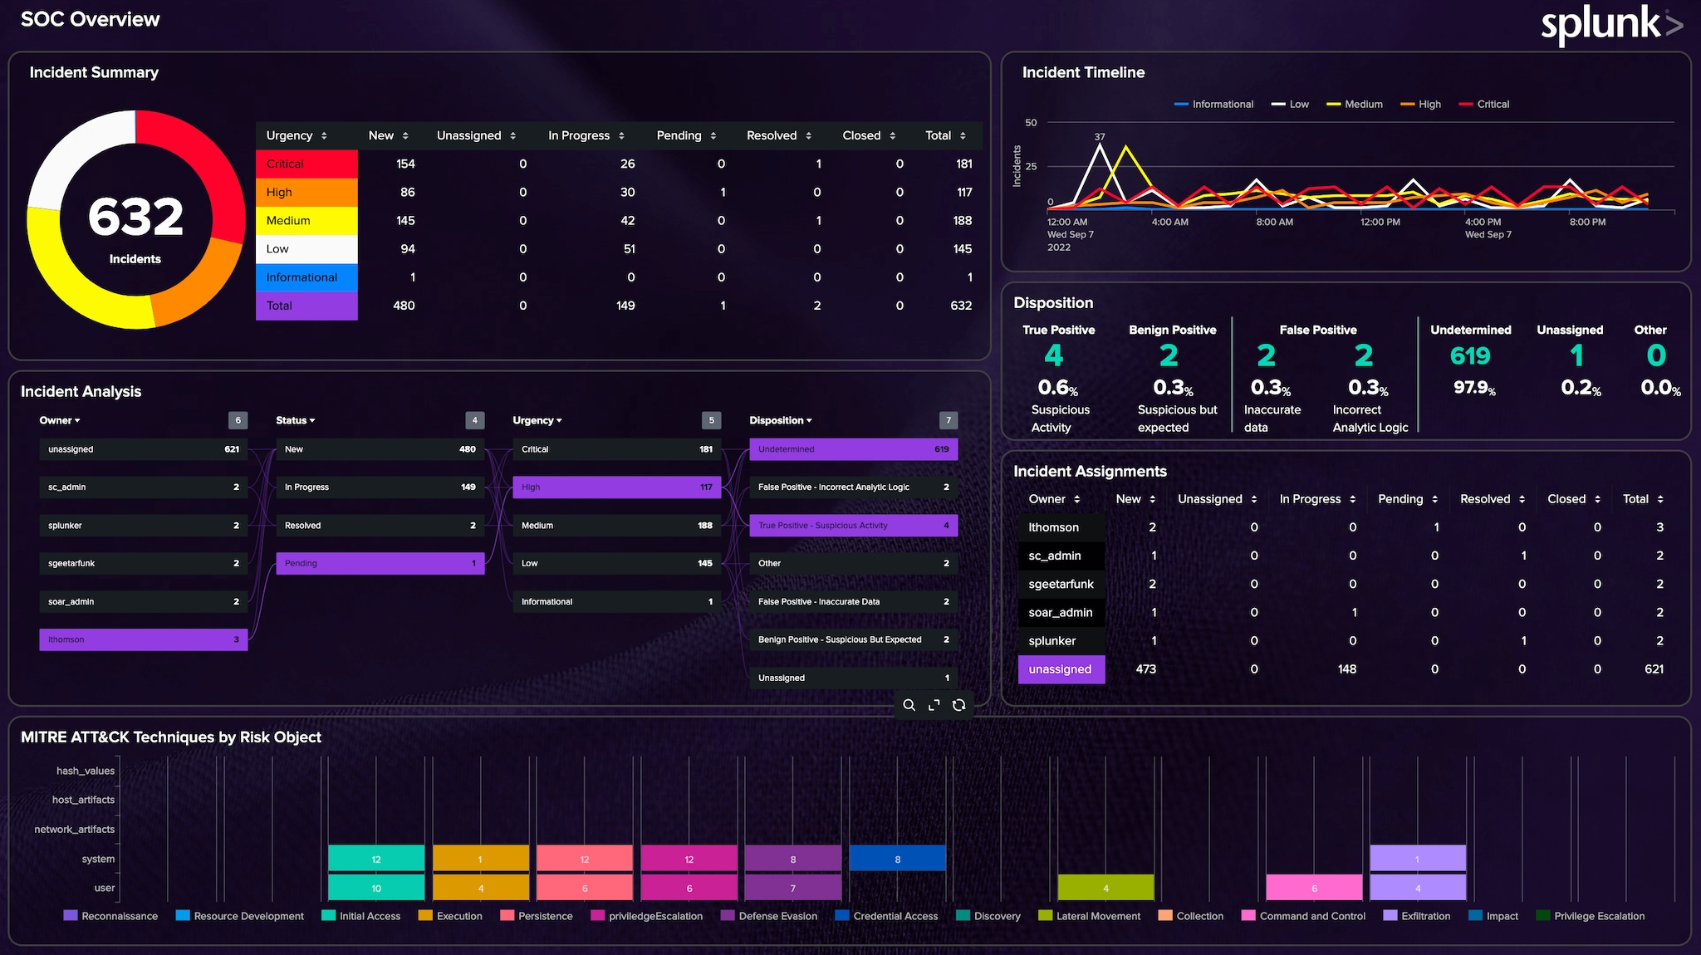
Network Security
Splunk was used for centralized monitoring and analysis.
A Splunk forwarder and Splunk server were set up in the network.
Syslogs from network devices including Fortinet, Cisco routers, switches, and the domain controller were forwarded to Splunk.
SNMP traps were also sent to Splunk for comprehensive real-time visibility on device status and health.

Slide 9
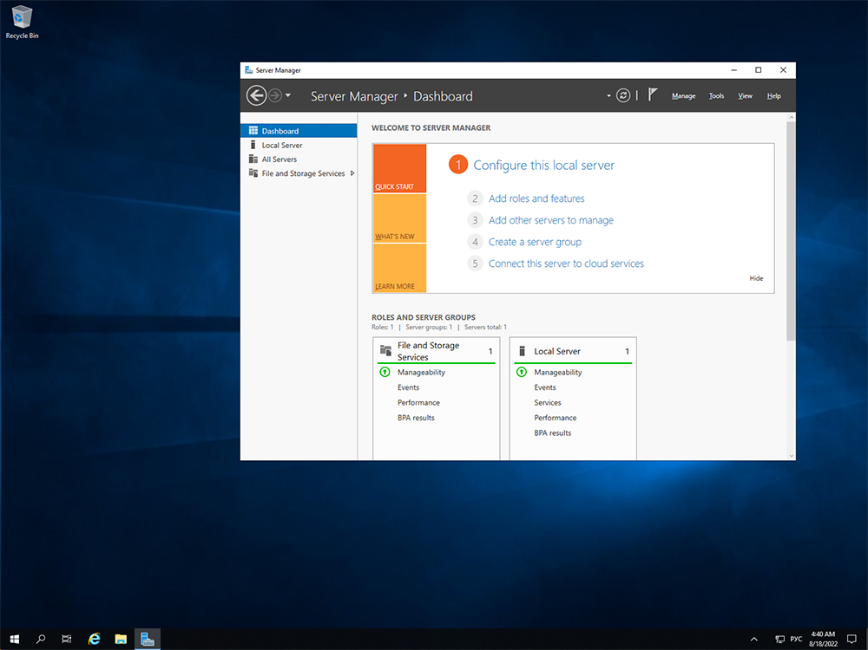
Windows
Each site had two domain controllers for redundancy and high availability
Active Directory replication was enabled across all sites for consistency
Organizational Units were created for each site and department to manage users and apply policies
Each site had its own DNS server with scavenging enabled to clean up old records
Local DHCP servers with failover were set up at each site for reliable IP address assignment
Group Policies were used to restrict USB and Control Panel access, enable auditing, and enforce strong passwords

Slide 10
Windows
A Windows Failover Cluster was set up at the Burnaby site using two file servers
Shared storage was configured with iSCSI so both servers could access the same data
A clustered file server role was created to host shared folders for users and apps
Failover testing showed the file server role moved smoothly when one server was shut down
A quorum witness was set to prevent split-brain scenarios and maintain cluster health
This setup keeps file services running during maintenance or unexpected issues
Least privilege access was used to keep the shared folder secure

Slide 11
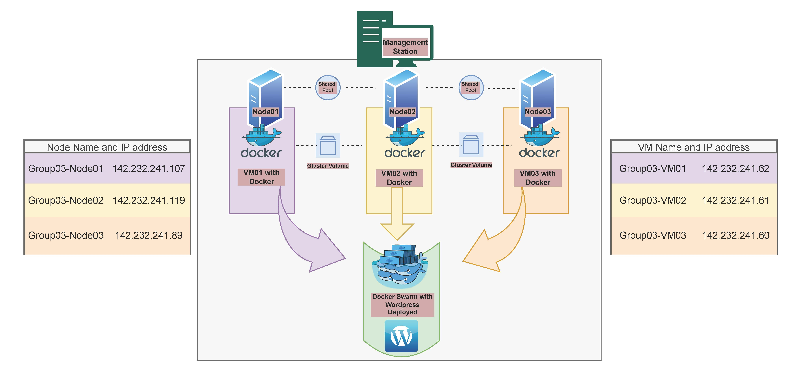
Proxmox
Installed Proxmox VE on 3 bare-metal nodes with cluster and HA enabled
Each node runs 1 VM; all VMs form a Docker Swarm (1 manager, 2 workers)
Deployed WordPress as a replicated Swarm service
Configured GlusterFS across VMs for shared container volume
Gluster volume mounted in WordPress containers for data consistency
Uploads are replicated across all nodes via Gluster
Simulated Proxmox node failure; VM auto-migrated via HA
WordPress remained online — confirming HA and storage redundancy

Slide 12
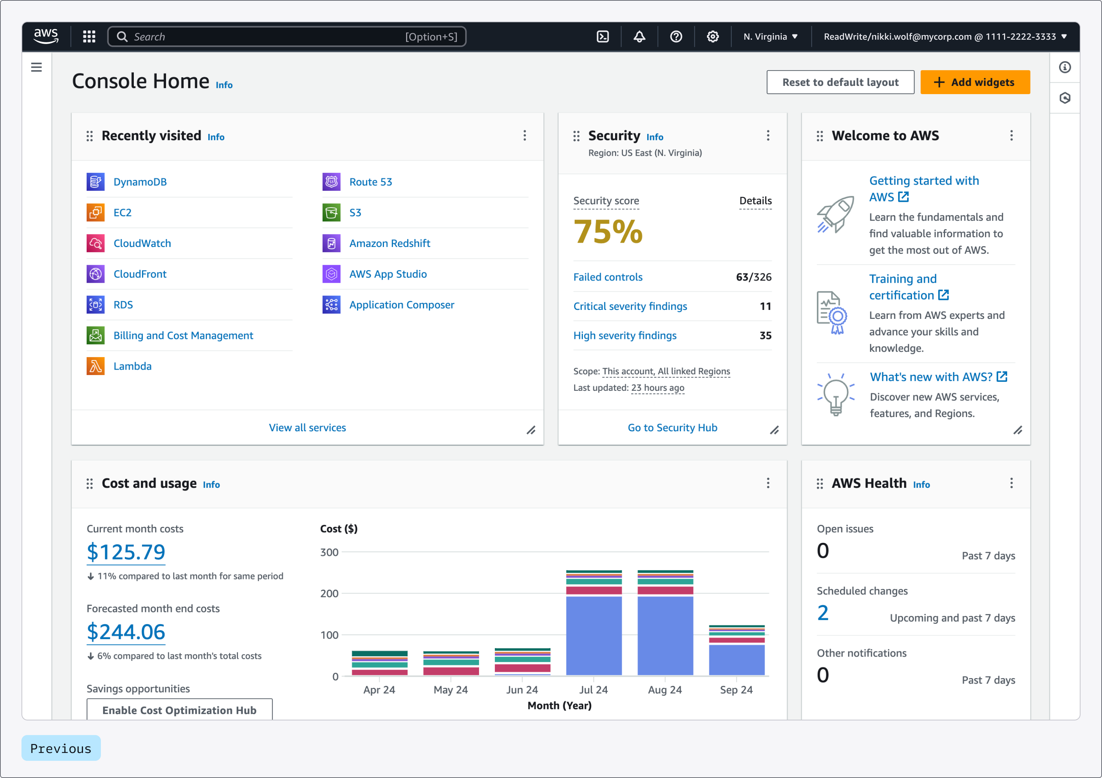
AWS
Custom VPC with public & private subnets, custom IGW and route tables
Site-to-site VPN to Cisco router with 2 tunnels for redundancy
Customer Gateway and Virtual Private Gateway configured
Static routes added for on-prem LAN via VPN
Launch template with Apache install script (user data)
Auto Scaling Group created with min=1, desired=2, max=4
Application Load Balancer (ALB) linked to target group
Security groups configured: HTTP (public) + restricted private access
Verified webpage via ALB DNS URL

Slide 13
Port Security issues
Challenges & Success

Slide 14

Challenges
AWS setup and cost management were challenging.
MPLS configuration required extra effort.
DHCPv6 setup on Windows posed issues.
Time constraints impacted our work.
Setting up OwnCloud on Docker was complex.
Integrating FortiGate into the network took time.
We had limited workstations and hardware.

Slide 15

Success
We met the project requirements to the best of our ability.
Configured network with DMVPN, OSPF, DHCP, and Sites.
Deployed WordPress using Docker.
Set up clustering and file server.
Ensured VM and router/network connectivity.
Configured server settings, including DNS, AD, and GPO.

Slide 16
Conclusion
This project provided us with meaningful insight into what our future roles in the industry may look like beyond BCIT. Over the course of two intense weeks, we gained hands-on experience in building and managing a fully functional network. We also learned how to navigate tight deadlines, adapt under pressure, and work as a cohesive team to achieve our goals. These challenges helped us grow both technically and professionally, and we walk away with valuable skills that will benefit us in our future careers.

Slide 17
Group 03 – Final Project
Questions?
Lakshmi, Manjinder, Toby, Alireza, Tony, Pouria, Suteash, Kien, Alireza, Parsa, Sahar

